Slide 2
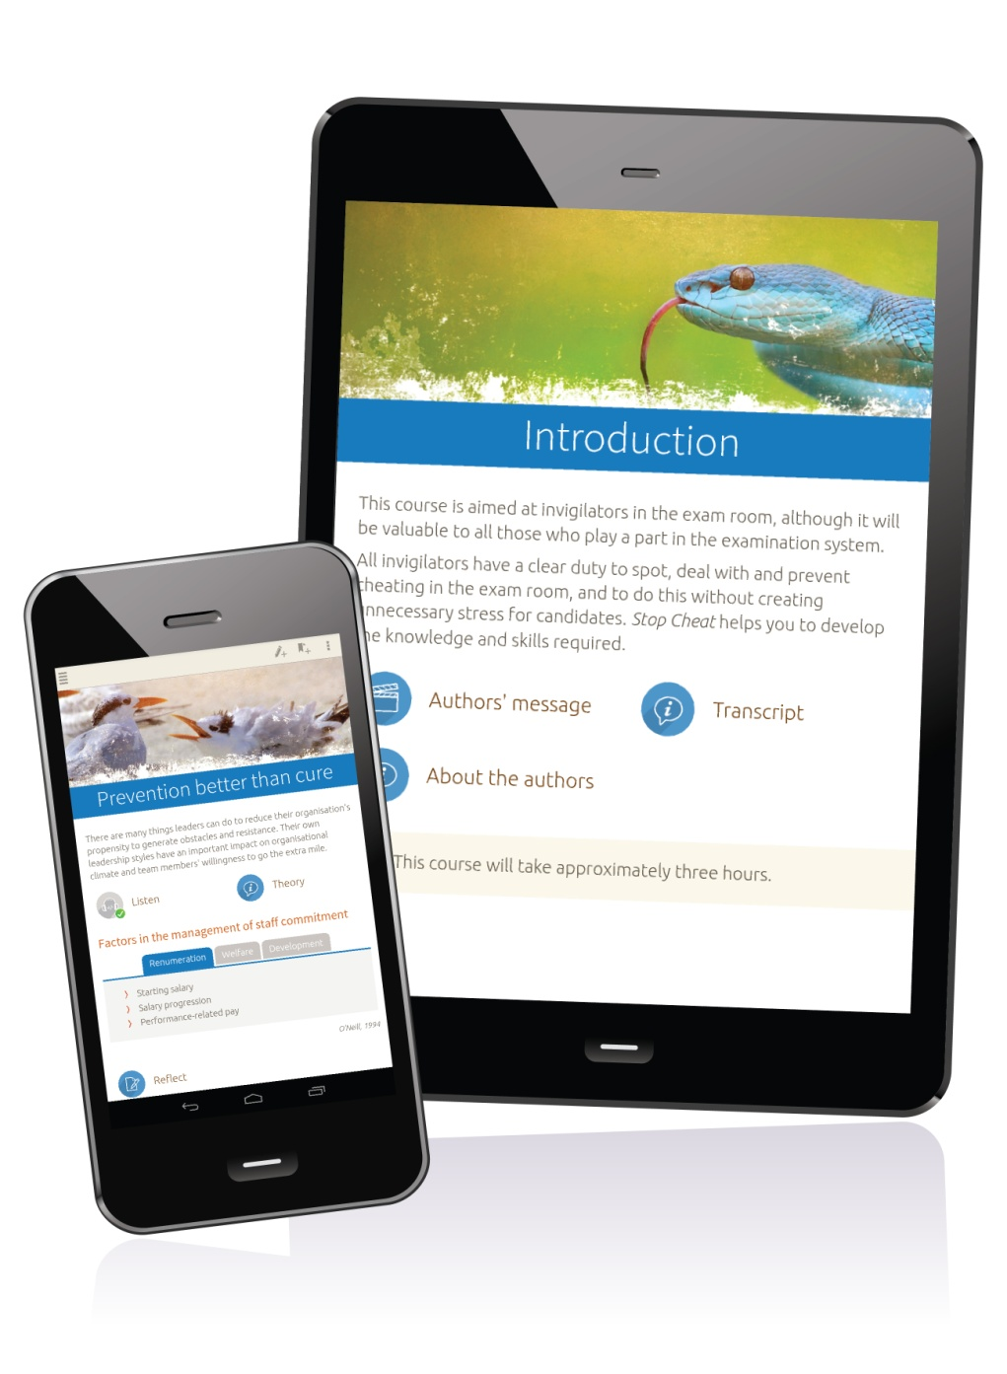
The CiC – Ready School Programme. Essential Training for Designated Teachers & School Staff

Slide 3
Interactive Learning..... Anytime, Anywhere

Slide 4
nimbl - what is it?
Our mobile course libraries are revolutionising the way staff and students access learning and training material. Every course is interactive, trackable and delivered straight to nimbl apps on mobiles, tablets and PCs.

Slide 5
Available offline via the nimbl mobile app or online via the web portal, our CiC – Ready School Programme is a cost-effective way of ensuring everyone from Designated Teachers to NQT’s & T.A’s, can access expert training all year long

Slide 6
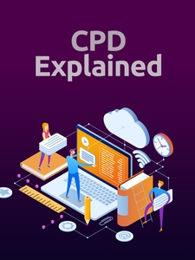
CiC -Ready Licence Publications Include:
https://w https://www.anspear.com/covers/plac.jpg ww.anspear.com/covers/plac.jpg

Slide 7
CiC -Ready Licence Publications Include:

Slide 8
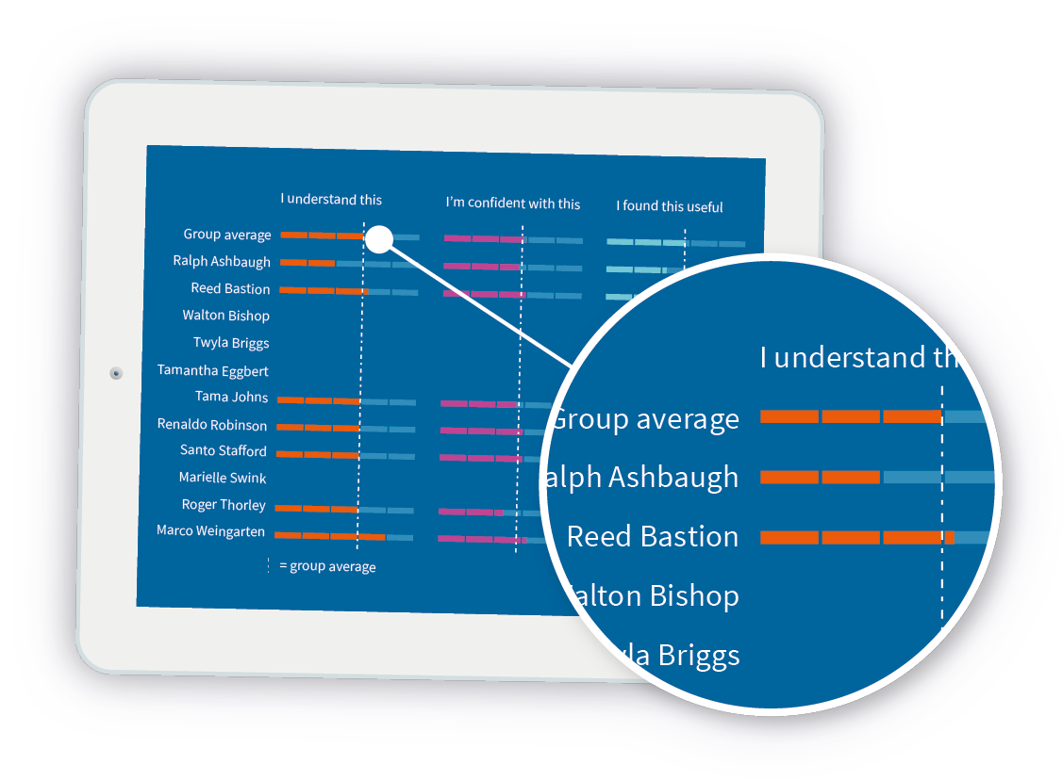
Benefits to Virtual Schools & Designated Teachers ...
Remote tracking
Monitor progress, performance & self-assessment
Live online graphs & regular PDF reports
Evidence of engagement

Slide 9
Regular Reporting (Cohort & Individual)

Slide 10
How to Access My Licence?...
On smart phones and tablets – download the nimbl app from the App Store or Google Play
Enter your unique user name and password
Download all of your resources
Via the web portal at www.go.nimbl.uk

Slide 11
Benefits ?
A wealth of information can be accessed at one tap on smart phones/tablets without using storage space
Can engage without the need for WiFi
Cost effective solution designed to support individuals not able to attend face to face training
Keep track of own professional development

Slide 12
On-Going Support
All Communication
Launch Events
Reports & Analysis
Support Meetings
Recycling of Licences
Certification
Automatic Updates

Slide 13
Get in Touch
Rachel Wiltshire
National Programme Manager
r.wiltshire@anspear.co.uk
07530 681355

