Slide 1
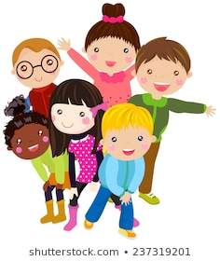
Children’s Mental Health Week Activity booklet
By the Mental Health Support Team
This year’s Children’s Mental Health Week theme is Express yourself!
This booklet will give you lots of things you can try out this week to express yourself and look after your mental health and wellbeing!
What you will find in this booklet:
Who are the Mental Health Support Team?
Design a poster all about wellbeing
Logo competition
5 Ways to Wellbeing challenge
Mindfulness

Slide 2
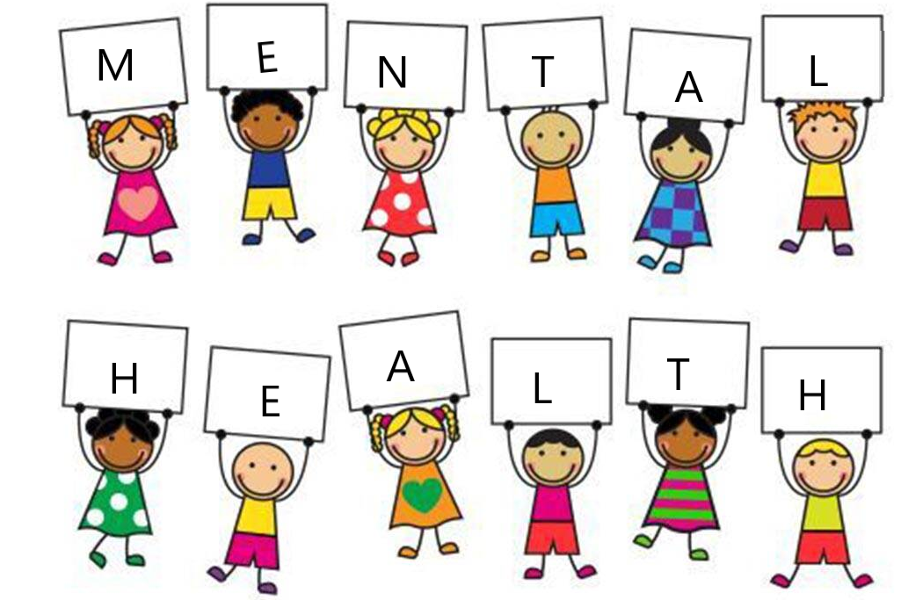
Mental Health Support Team
We are the Mental Health Support Team (MHST) working within some schools in the Telford & Wrekin area to support pupils, school staff and families.
We work with lots of children and young people supporting them with things such as anxiety, exam stress, low mood, sleep, worry management and many more!
If you feel that you would benefit from support from the MHST, speak to your teacher or another member of staff at your school to see if we work within your school. If we are not in your school they can look at other supports for you..
You may know who we are, or, you may not of ever heard of us, and that’s ok! We would really like everyone's involvement in expressing themselves this week and support to develop some things which we would love you to be a part of!

Slide 3
Poster design!
Express yourself by being creative and making a poster all about mental health and wellbeing!
Ideas of what to include:
What does mental health mean to you?
What can people do to stay well?
What are some of the different emotions people experience?
What can people do if they are feeling worried, sad or stressed?
Who can you go to for help?
Top tips for designing a poster!
Posters should be designed on a4 size paper
Make a plan of what to include
Give your poster an eye catching title
Think of colours and pictures you would like to include
Email a photo or copy of your poster to your school if you would like to have it featured in our poster booklet which will be shared around all our schools!
Would you like your poster featured in our poster booklet?

Slide 4
The Mental Health
Support Team need a new logo and we would
like your help
in designing one!
Logo competition!
Design a logo and email a photo or copy of your completed design to your school who can enter you in to our competition!
What to include in your logo design:
All logo’s need to include the name of our team: Mental Health Support Team
Logo’s should be designed on an A4 piece of paper
Be as creative and colourful as you like!
The winning design will be used as the Mental Health Support Team logo!

Slide 5
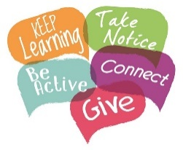
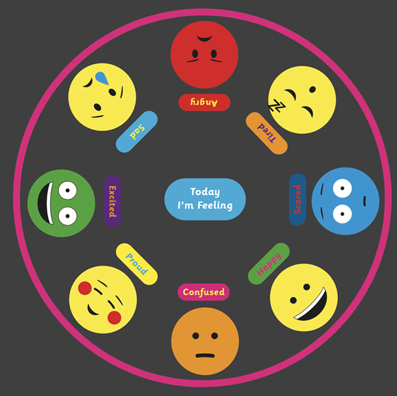
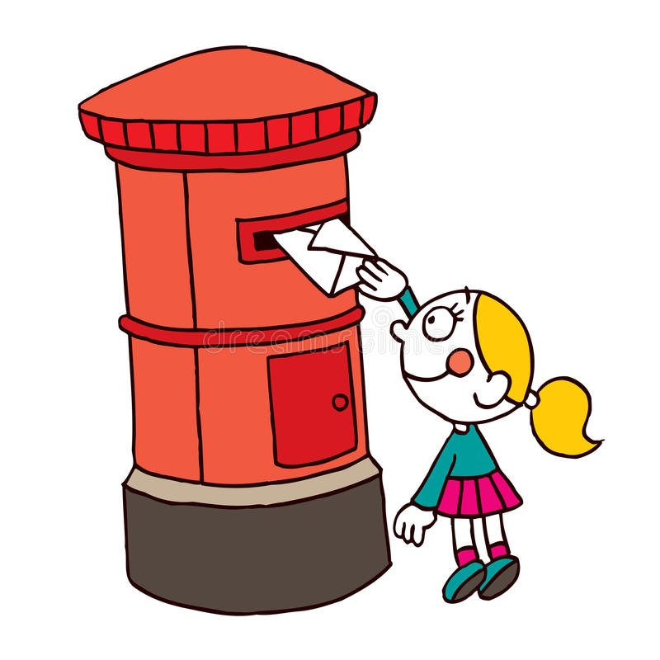
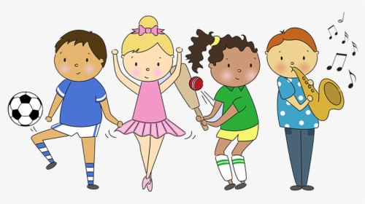
5 Ways To
Wellbeing
Challenge
We have thought of 5 activities that you could try this week to help you feel really good about yourself, see if it works for you! Choose any one for each day and just go for it! We would love to hear how you get on with them.
Have a look at this emotion wheel, see if you can find the one that you feel before, during and after each activity. Make your own emotion wheel if you would like and add some more!
Connect
Do you know anyone who might like to receive a letter from you? Maybe you can’t see them right now or maybe they live alone?
We all like to receive things through the post, it makes
us feel special and warm inside. Post it in the letter box
or through their door if they live close!
Write a letter, do a drawing or anything else you can think
of that will make that person feel great and connected to you. This is an act of kindness that will brighten someone’s day! Check how you feel after posting it using the emotion wheel!
Be active
Today, think of something new to do. We are quite limited at the moment but that means we can use our imaginations even more! Play a pretend game outside, you make up the rules, it’s all yours!
See how many times you can go up and down the stairs in an hour, find something online that you can do, dance, PE and do it the very best you can! Being active releases chemicals called endorphins and make us feel happy and positive. How do you feel after doing this? Did it work?

Slide 6
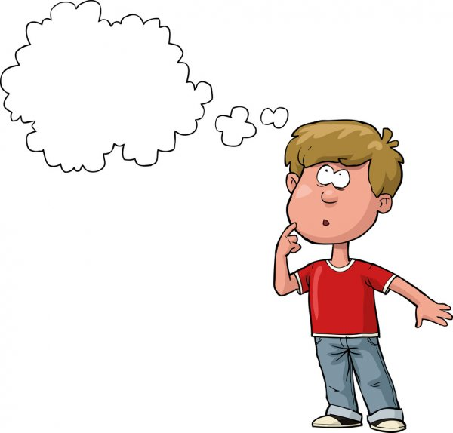
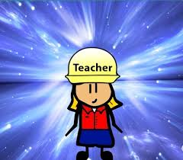
What are my thoughts?
How is my body feeling?
What do I need?
Take Notice
Today take notice of yourself. How are you feeling? Can you describe it in words? In pictures? Do you feel different emotions throughout the day? See if you can write a poem, draw a picture, a dance – anything that shows that you have noticed how you are feeling. If you want to maybe show someone and have a chat about it.
Give
Today is your turn to be the teacher, you are in charge!!! Think of something you like doing – this could be a game you play with your family, a dance routine, a type of sport, something you can play online, so many options! Write or draw instructions for it and send it to anyone you think might like to give it a go! How does it feel to make someone else feel that good too?
Keep Learning
What do you like to do? Is there something that you find yourself drawn to? Maybe a hobby like painting, horse riding, cycling, reading? Can you find out some facts about it that you don’t already know or learn a new skill? For example if you like painting have a look at a famous artist that you might like and try and copy how they paint. This isn’t for school, it’s for you! Share what you have learnt with someone, have fun!
Is there a place you would like to visit some day?
Well done to you if you have done some, or all of these things!
Remember, you can change any of them to suit you and do them any time you like, not just this week!
We would love to know what you have enjoyed doing, tell your teacher and they can pass it on to us!

Slide 7
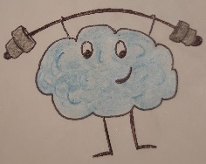
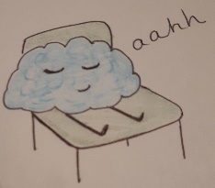
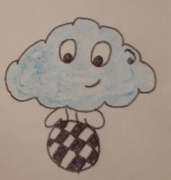
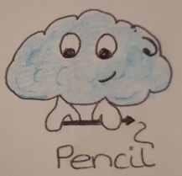
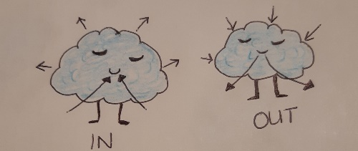
Mindfulness!
Just like our bodies, our brains need looking after to
keep them healthy and strong.
Our brains need exercises that challenge it like playing games,
doing puzzles and learning at school or at home during lockdown.
Our brains are working all the time and never sleep.
So we need to help it learn to rest and relax.
Mindfulness helps our brains exercise and relax at the same time! Clever isn’t it?
Mindfulness exercises get the brain to focus on one thing only. By focusing on just one thing the brain does not need to think about things in the past, or plan for the future so it can relax and focus.
Mindfulness can be tricky to start with as the brain like to think ALOT. By practice mindfulness exercises it makes it easier, just like when we learned to how to ride a bike, swim or play football. Once it knows what to do your brain will enjoy it and say thank you!
Here are a couple of ways you can practise mindfulness!
Mindful object
Choose an object. It can be a pen, a hair brush, even chocolate! Now set a timer for 4 minutes then using your senses:-
LOOK - notice its size, shape, colour, shiny?
FEEL - is it soft? Hard? Cold? Warm? Fluffy?
LISTEN - does it make any sound as you move it?
SMELL - does it smell of anything? If so what?
TASTE - if it is food eat slowly and notice anything you can feel or taste in your mouth for 1 minute.
Mindful breathing
Sit or Lie comfortably, place your hands or a book on your stomach.
Focusing on your breath, breathe IN…,
breathe OUT…,
breathe IN…,
breathe OUT…
Do this for 10 breaths and notice when your hands/book lift up and lowers in time with your breath.

