Slide 1
Contact Tracing for children and young people from 19 July 2021
COVID-19 Contact Tracing:
To be updated by Product assurance team prior to publication.​
Further guidance will be developed by the devolved governments.
These are working documents and subject to change through the course of the testing programme rollout.

Slide 2
This document and other guidance available
1
This document provides an overview of the changes to the identification of close contacts following a positive PCR test for education and childcare settings from 19 July 2021.
Table of contents
What is the change
Contact Tracing Journey
Key Questions
Further support/ Questions

Slide 3
What are the changes to contact tracing from 19 July 2021?
From 19 July, education and childcare settings (i.e. schools, colleges and nurseries) will no longer carry out routine contact tracing. From this point onwards, close contacts will be identified and contacted by NHS Test and Trace.
As with positive cases in any other setting, NHS Test and Trace will speak with the individual who has tested positive – or, depending on their age, their parent or legal guardian – to identify close contacts.
Contacts within schools, colleges and nurseries will only be traced by NHS Test and Trace where the positive case specifically identifies the individual as having close, prolonged contact. NHS contact tracers will provide support on how to identify a close contact. The setting will not routinely be contacted to provide details of close contacts.
Schools, colleges and nurseries may be contacted in exceptional cases to help with identifying close contacts where there is a local outbreak, as currently happens in managing other infectious diseases.
Symptomatic individuals, and those who record a positive test, will still need to isolate in line with current guidance.

Slide 4
What are the changes to self-isolation from 16 August 2021?
Self-isolation rules for close contacts in all settings are changing on 16 August.
From 16 August close contacts who are fully vaccinated or those under 18 will not need to self-isolate
All close contacts will be advised to take a PCR test – you should encourage anyone identified as a close contact to do this
Individuals identified as close contacts will not need to self-isolate while they are awaiting the results of their test
If the PCR result is positive, the individual must isolate and NHS Test and Trace will work with them to identify any close contacts

Slide 5
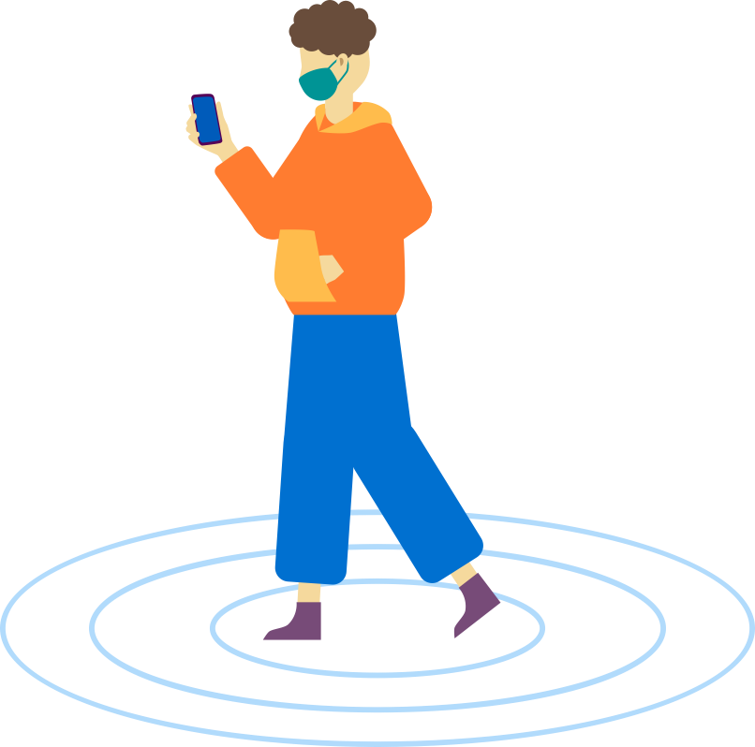
Contact Tracing Journey
IMPORTANT: If, at any point, a student, pupil or staff member begins displaying symptoms they must follow government guidelines, order a PCR test and self-isolate.
For children and young people in education and childcare settings
1
2
3
4
Symptomatic or Positive Test
A child is symptomatic or records a positive LFD Test with NHS Test & Trace (T&T)
Isolation
The individual isolates immediately and orders a confirmatory PCR test as soon as possible
Result notification
The child / family is contacted by NHS T&T with the test result. If it is positive, the individual MUST continue to self-isolate. The child / family should inform their setting
Contact Tracing
NHS T&T contact tracers will then contact those who test positive – or their parent or legal guardian if they are under 18 years – to identify close contacts
8
7
6
5
Local Outbreak
Education and childcare settings may be contacted by their Local Health Protection team if there is an outbreak
Advice to Contacts
NHS T&T will get in touch with close contacts and advise them to self-isolate in line with current guidance. From 16 Aug guidance on self-isolation will change
Contact Details
Where known, the contact details of the identified close contacts will be passed to the contact tracers
Questions
NHS T&T will ask a series of questions to help the individual identify any close contacts
Signpost to other advice:
Support if you’re off work while self-isolating: https://bit.ly/isolatesupport
If you’re worried about your health, visit https://www.nhs.uk/ or call 111.
Remote learning advice: https://bit.ly/covidhomelearning
Printable action list for schools/colleges for children with symptoms
!

Slide 6
Key Questions
1
Why are Test and Trace taking over contact tracing from education and childcare settings?
Education and childcare settings have done a brilliant job in identifying contacts over the course of the pandemic, but this resource intensive. NHS Test & Trace already manage the contact tracing process for the rest of society and have developed expertise in supporting people to identify close contacts.
2
How will a child or young person know what is meant by ‘close contact’?
NHS Test & Trace will contact those who test positive – or their parent or legal guardian – to identify close contacts. They will ask a series of specific questions to help the individual understand what is meant by a close contact, making it easier for them to be identified. Contacts in an educational setting would only be traced if the positive case specifically identified an individual as having close, prolonged contact. The education or childcare setting would not be contacted to provide details of close contacts.
3
What does a close contact have to do?
Until 16 August, in line with current guidance, anyone identified by NHS Test and Trace must self-isolate for 10 days from the date of last contact with the positive case, and not attend their education or childcare setting. They should also take a PCR test. They must continue to self-isolate for the full period even if the test is negative. From 16 August, in line with fully vaccinated adults, under-18s identified as close contacts will not need to isolate and instead will be advised to take a PCR test. Further guidance will be provided shortly.
4
How will a setting know if a student, pupil or member of staff has tested positive?
Pupils, students and staff members who record a positive LFD or PCR test should let their setting know. Individuals who return a positive LFD result will need to self-isolate immediately and order a confirmatory PCR test. If the PCR test is taken within 2 days and is negative, the individual no longer needs to self-isolate. If the PCR result is positive, the individual must self-isolate and contact tracing will be conducted by NHS Test & Trace.
You can find the answers to more questions by looking at our Frequently Asked Questions document.

Slide 7
Where to find more information
Latest information on Contact Tracing is available at:
Link to operational guidance
Link to Tracing FAQs
This page will be regularly updated to include:
Q&A
?
?
?
?
?
?

